Slide 1
Deep Learning Assignment 2
S10223485H – Tran Huy Minh

Slide 2

1. Overview
Develop text generation model using Harry Potter Chamber of Secrets as dataset
Model should be able to generate text similar to what is seen in the book
Multiple models built

Slide 3
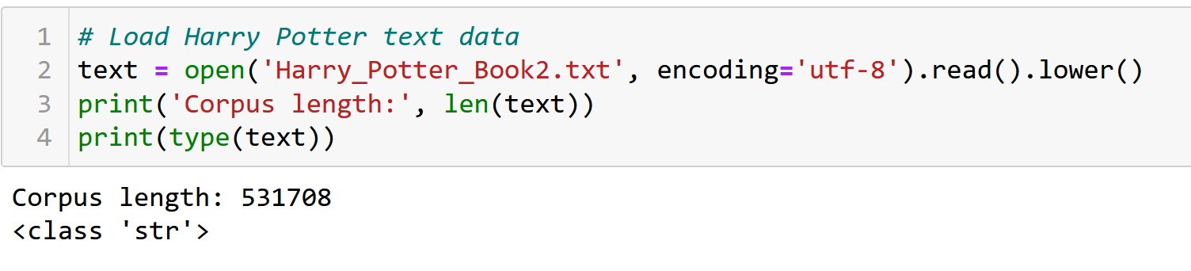
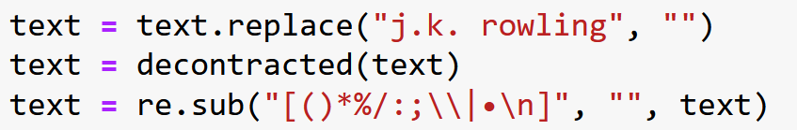
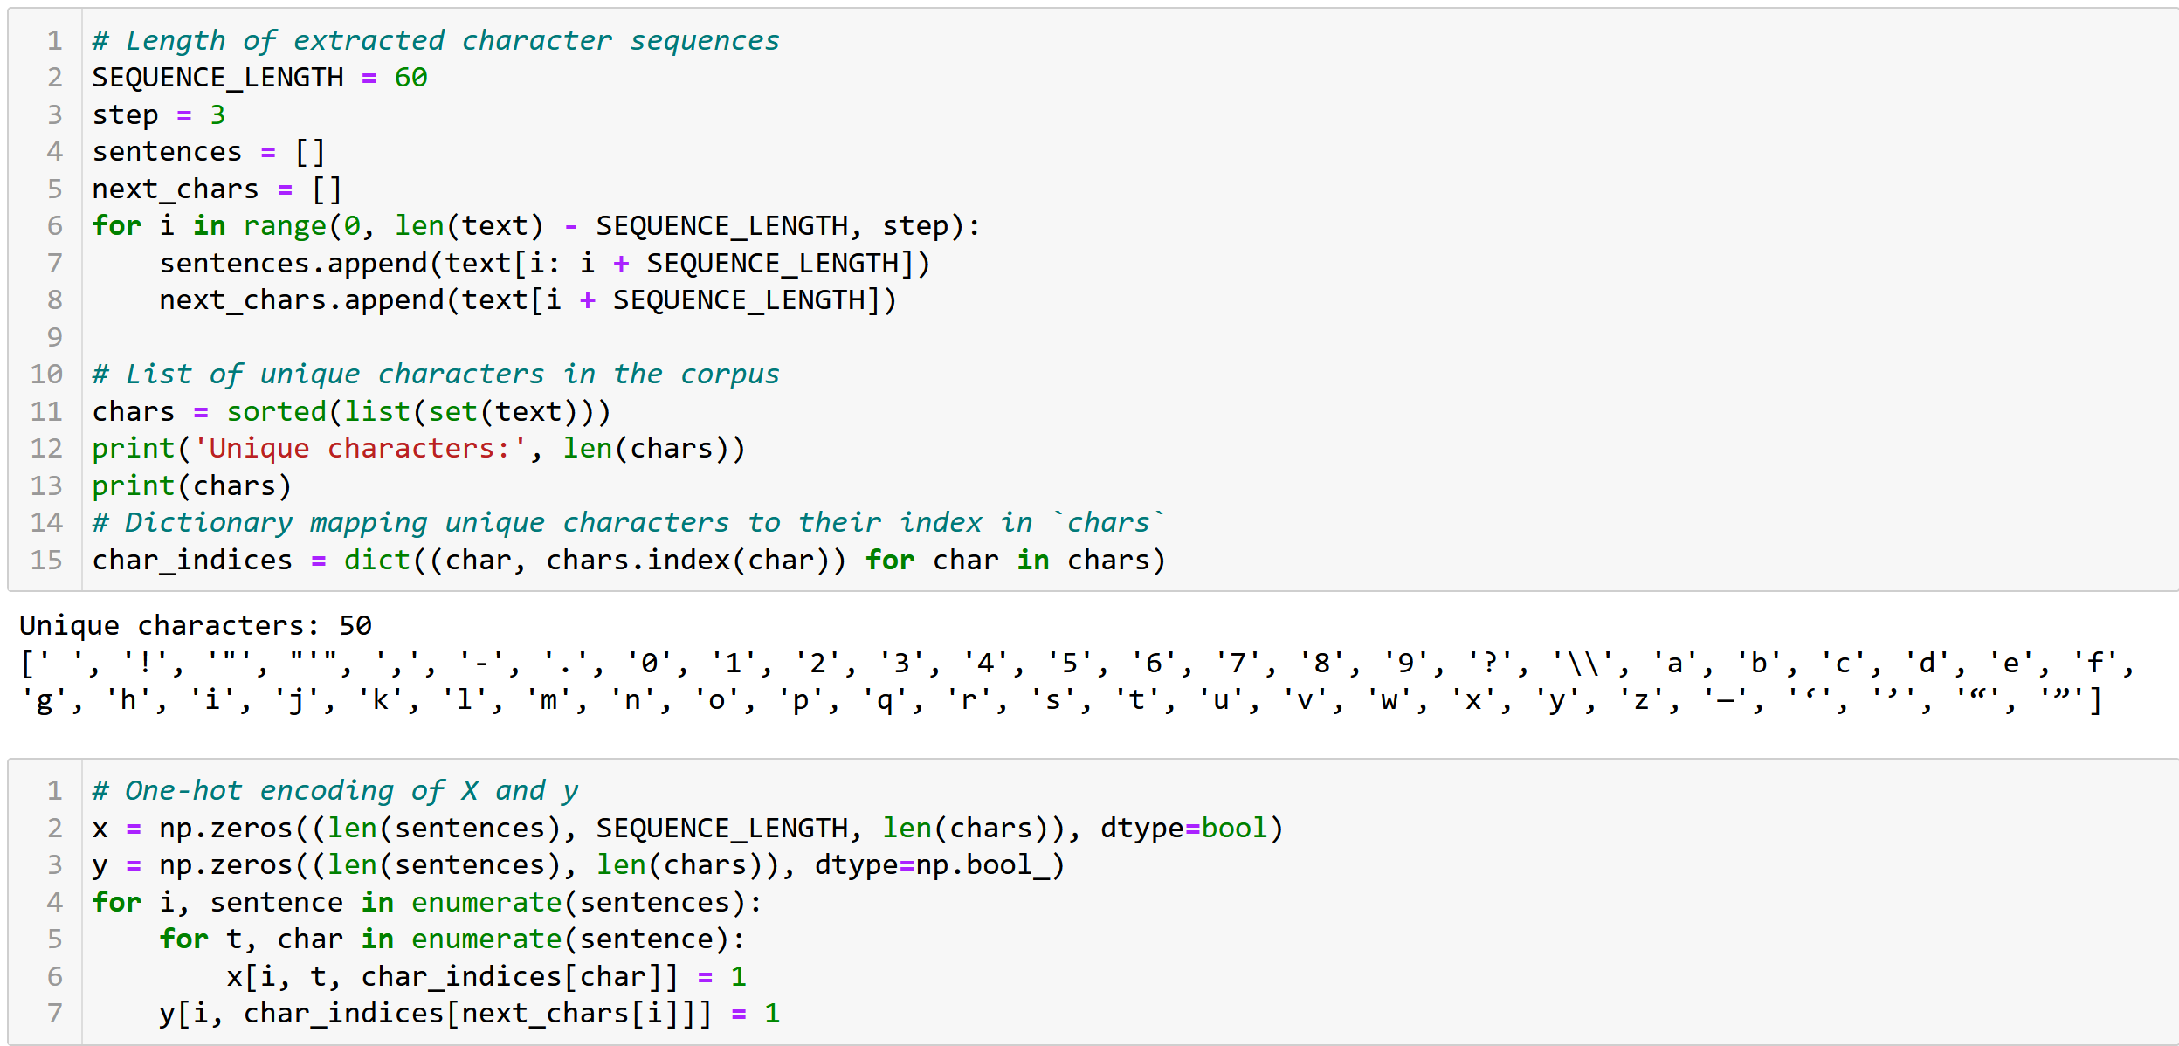
2. Data Loading and Processing

Slide 4
3. Develop Sequence Generator Models
Model | Test/Tune/Changes | Train Accuracy | Test Accuracy
1 | Baseline Model – only embedding layer | 39.76% | 36.96%
2 | Used LSTM layer with 32 units | 44.42% | 45.13%
3 | Used GRU layer with 32 units | 47.01% | 47.55%
4 | Increased GRU neuron units to 128, used RMSprop learning rate of 0.001 | 56.82% | 55.09%
5 | Used LSTM layer with 128 units | 54.40% | 53.16%
6 | Used two GRU layers with 128 units each, increased learning rate to 0.002 | 64.36% | 58.46%
7 | Increased one layer’s units to 256, added dropout of 0.2, increased learning rate to 0.003 | 60.99% | 58.60%
8 | Increased other layer’s units to 160, added another dropout of 0.2, increased learning rate to 0.004, added L2Regularizer of 0.01 | 54.20% | 54.56%
9 | Reduced units back to 128, removed one dropout | 55.04% | 55.27%
10 | Doubled number of units for both layers, increased dropout to 0.3, decreased regularizer to 0.005, used Adam learning rate of 0.001 | 65.19% | 59.51%
11 | Increased regularizer back to 0.01 | 63.69% | 59.11%
12 | Increased dropout to 0.35 and learning rate to 0.0015, 20 epochs | 64.23% | 58.93%

Slide 5
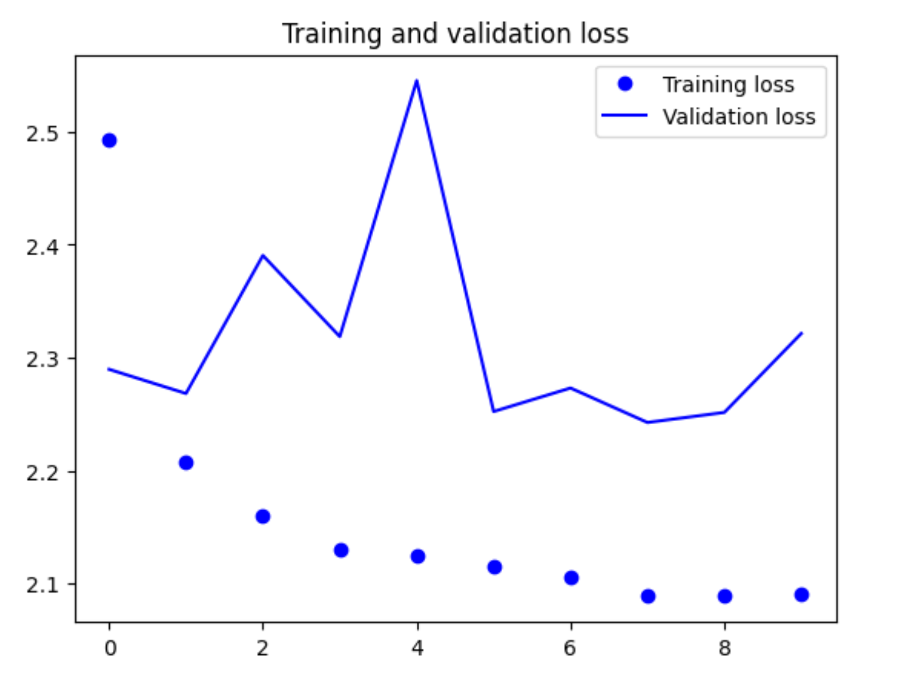
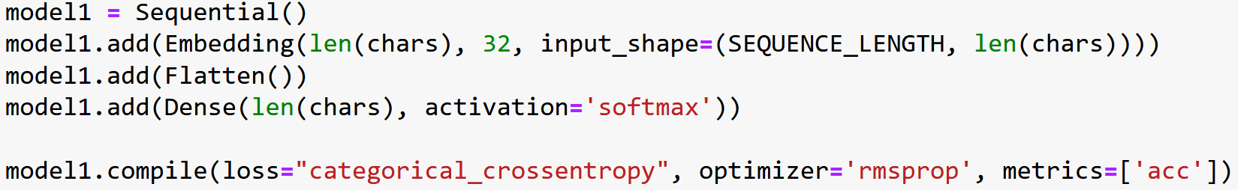
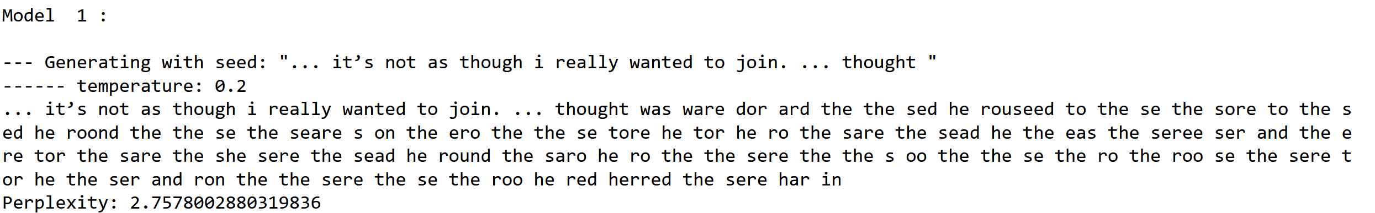
3. Develop Sequence Generator Models

Slide 6
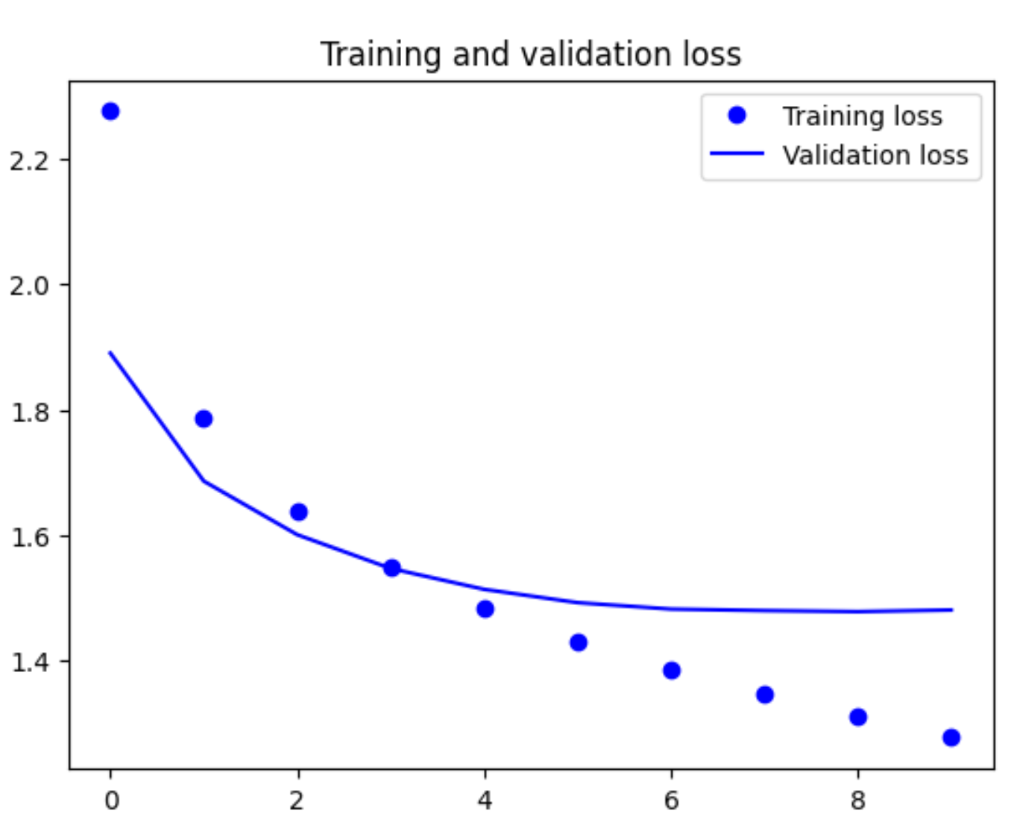
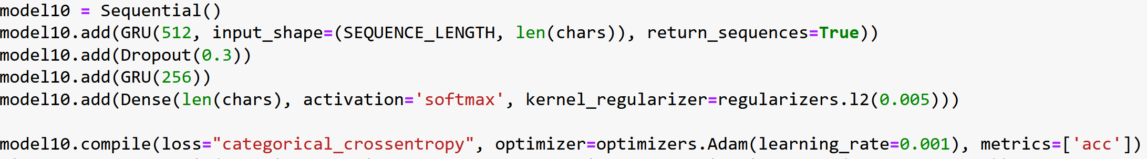
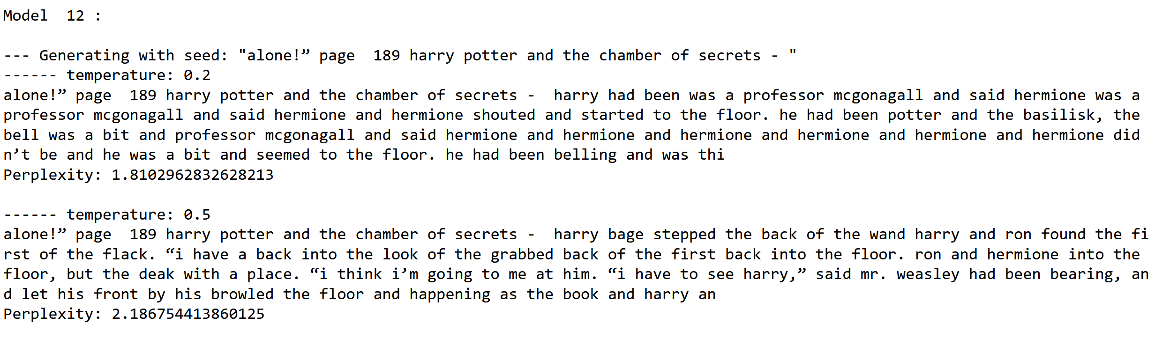
3. Develop Sequence Generator Models

Slide 7
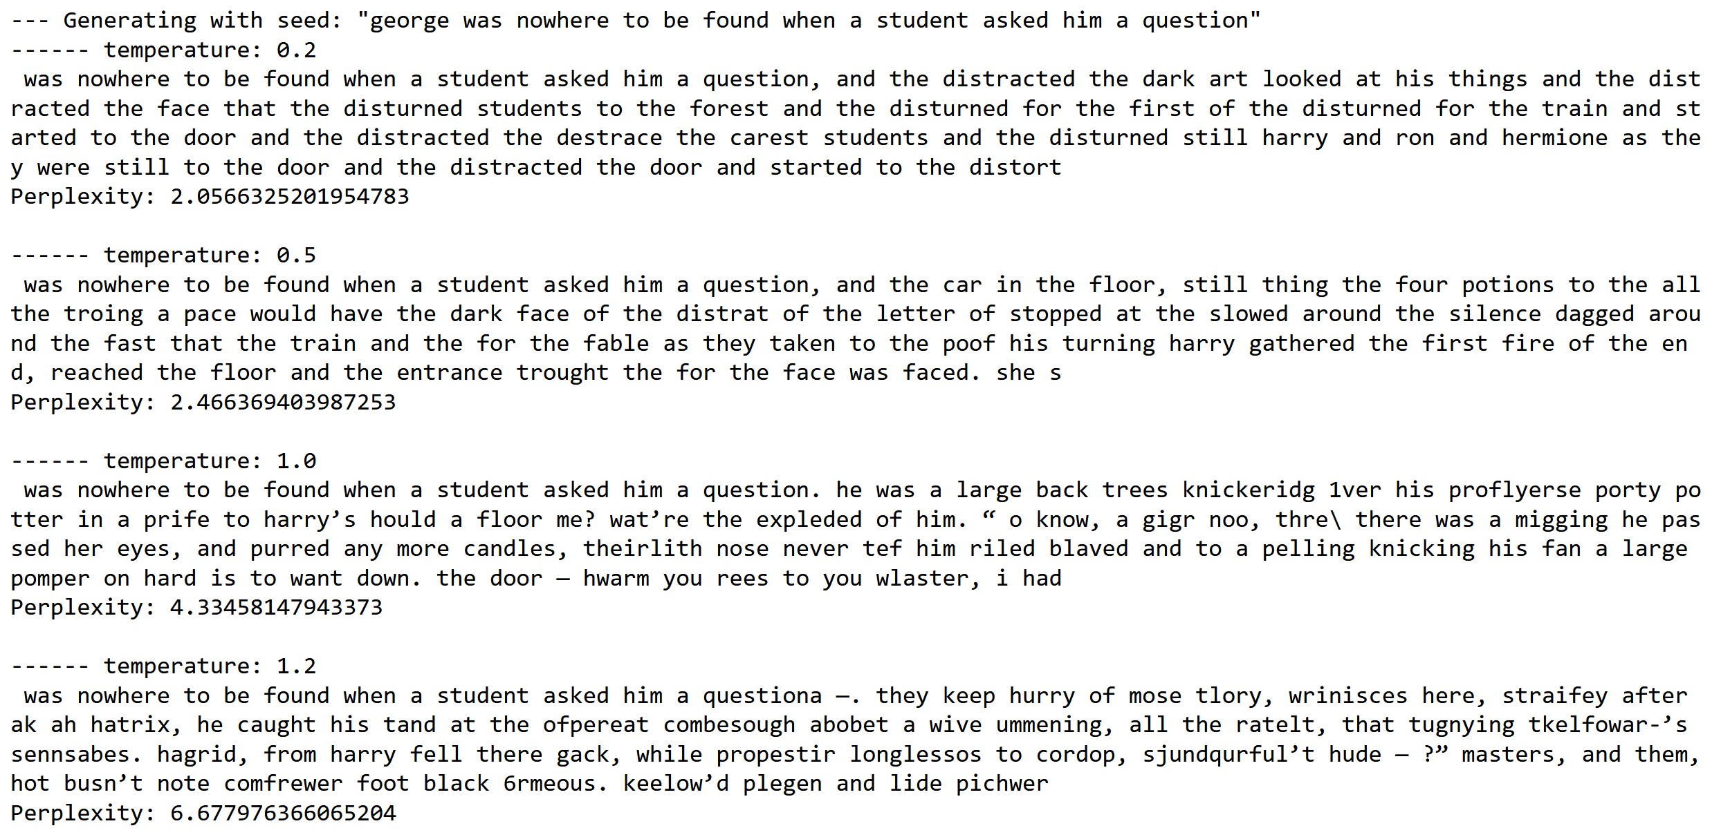
4. Use the developed Model to Generate Texts

Slide 8
5. Summary
10th model showed best results with a testing accuracy of 59.51%.
Text generation was coherent at lower temperatures but failed at higher temperatures.
To improve text generation, suggestions include:
Expanding the training dataset through data augmentation techniques
Improving data preprocessing techniques, such as using Word Embeddings or BERT encoding
Using a larger training dataset
Fine-tuning hyperparameters such as number of units, dropout rate, learning rate, regularization, and temperature
Incorporating attention mechanisms into the model.

Slide 9
6. Reflection
For problem 1, gathered review data, performed data preprocessing, trained numerous models and tuned hyperparameters. The best model was able to predict sentiments of the reviews.
For problem 2, learned about different preprocessing techniques and simple models performed the best in text generation.
Found interesting that preprocessing had a significant impact on the model's accuracy in problem 1.
Had a hard time generating coherent text in problem 2, but the problem was solved by ensuring the input length matched the model's input length.

